Slide 1



Tender Ease
01.04.24
Команда Индусы
Стараемся во славу слоников
Information available in audio.

Slide 2





Наша
Супер
Команда
Пашкова АРина
Teamlead
Шилов Лев
Chief Finance Officer
Чибиток Даниил
Briefly elaborate on
what you want to discuss.
Director
Рахматуров Андрей
Accountant
Drag and drop your photo or video! Click the sample photo or video and delete. Select yours from the uploads tab, drag, and then drop inside the frame!
Жаворонков Максим
Finance Manager

Slide 3

Технологическая информация
Наш стек
Backend: Java
Базы данных PostgreSQL
Машинное обучение (Machine Learning)
Frontend: React
Back to Agenda

Slide 4



Дополнительный функционал предоставленный нашей командой
Вау-фичи
Parcing # 1
ML # 2
UI/UX design # 3
Парсинг в реальном времени
Машинное обучение для релевантного поиска
Универсальный дизайн
Back to Agenda

Slide 5
Описание продукта
Briefly elaborate on what you want to discuss.
Back to Agenda

Slide 6

Parcing # 1
Briefly elaborate on what you want to discuss.
Mission
Vision
Write the company's
mission statement here.
Write the company's
vision statement here.
Back to Agenda

Slide 7

ML # 2
Use links to go to a different page inside your presentation.
Highlight text, click on the link symbol on the toolbar, and select the page in your presentation you want to connect.
Пользователь использует фильтры
Успешные нажатия на фильтры передаются на сервис
Данные сохраняются
Вычисляется вес каждого фильра
Add more sub-ideas
2. Ранжировка по перемножению веса фильтра на его совпадение
Пользователь задает фильтры
Данные попадают на сервер
1. Ранжировка по налчию продукта
Приоритезированный список тендеров
Add a related idea
Add even more sub-ideas
Add a related idea
Add more sub-ideas
Add even more sub-ideas
Add more sub-ideas

Slide 8
UI/UX design
Briefly elaborate on what you want to discuss.
Back to Agenda

Slide 9
Roadmap
Briefly elaborate on what you want to discuss.
2022
2023
2024
2025
Write an achievement, successful project or milestone here.
Write an achievement, successful project or milestone here.
Write an achievement, successful project or milestone here.
Write an achievement, successful project or milestone here.
Back to Agenda

Slide 10
Конкуретные преимущества
Briefly elaborate on what you want to discuss.
*Dollar amounts are in millions | FY '25 | FY '26 | YOY change
Revenue | $ 000 | $ 000 | %
Expenses
Profit
Dividend/share
Customize this table! Just right-click on any cell to see all the available table functions.
To merge, first highlight two or more cells, then click "Merge Cells" to organize your table according to your needs!
Back to Agenda

Slide 11
Выводы
10 Billion
5 Billion
Total Available Market (TAM):
10 Billion
1 Billion
Serviceable Available Market (SAM):
5 Billion
Serviceable Obtainable Market (SOM):
1 Billion
Back to Agenda

Slide 12

ADD COMPANY NAME
Connect with us.
Email
hello@reallygreatsite.com
Social Media
@reallygreatsite
Call us
123-456-7890

Slide 13
Our Market
10 Billion
5 Billion
Total Available Market (TAM):
10 Billion
1 Billion
Serviceable Available Market (SAM):
5 Billion
Serviceable Obtainable Market (SOM):
1 Billion
Back to Agenda

Slide 14
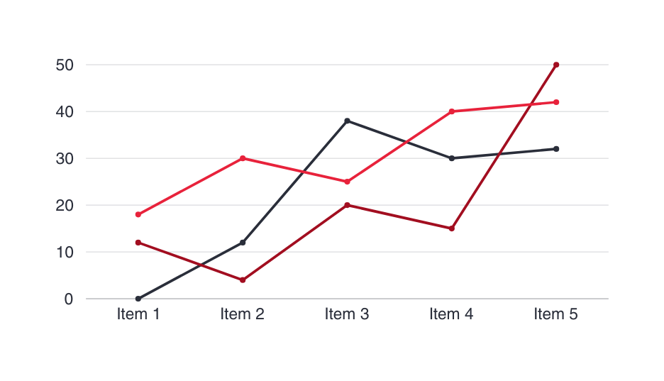
Our Traction
Briefly elaborate on what you want to discuss.
Monthly Revenue:
10 Billion
Average Revenue/Customer:
$100,000
Monthly Revenue Growth:
50%
Back to Agenda

Slide 15
Financial Guidance
Briefly elaborate on what you want to discuss.
*Dollar amounts are in millions | FY '25 | FY '26 | YOY change
Revenue | $ 000 | $ 000 | %
Expenses
Profit
Dividend/share
Customize this table! Just right-click on any cell to see all the available table functions.
To merge, first highlight two or more cells, then click "Merge Cells" to organize your table according to your needs!
Back to Agenda

Slide 16




Use this for a photo caption.
Drag and drop your photo or video! Click the sample photo or video and delete. Select yours from the uploads tab, drag, and then drop inside the frame!

Slide 17





Collaborate on a Whiteboard
Write a note here
Write a note here
Tip: Collaboration makes teamwork easier! Click "Share" and invite your teammates to fill this up. Use this page for bulletins, brainstorms, and other fun team ideas.
Right-click on the background of the slide, or on the thumbnail below, for the option to expand this page into a whiteboard for more space!
Copy a note, drag to the board, and write your ideas.
Copy a note, drag to the board, and write your ideas.

Slide 18
Collaborate on a Whiteboard
Add even more sub-ideas
Add more sub-ideas
Add more sub-ideas
Add even more sub-ideas
Add a related idea
Add a
main topic
Add a related idea
Add a related idea
Add even more sub-ideas
Add a related idea
Tip: Collaboration makes teamwork easier! Click "Share" and invite your teammates to fill this up. Use this page for bulletins, brainstorms, and other fun team ideas.
Right-click on the background of the slide, or on the thumbnail below, for the option to expand this page into a whiteboard for more space!
Add more sub-ideas
Add even more sub-ideas
Add more sub-ideas

Slide 19
Resource
Page
Use these design resources
in your Canva Presentation. Happy designing!
Delete or hide this page
before presenting.

Slide 20

























Resource
Page
Use these design resources
in your Canva Presentation. Happy designing!
Delete or hide this page
before presenting.

Slide 21
Resource
Page
Use these design resources
in your Canva Presentation. Happy designing!
Delete or hide this page
before presenting.

Slide 22
Resource
Page
B for blur | C for confetti
D for a drumroll | M for mic drop
O for bubbles | Q for quiet
U for unveil | Any number from 0-9 for a timer
Find the magic and fun
in presenting with Canva Presentations. Press the following keys while on
Present mode!
Delete or hide this page
before presenting.

Slide 23
Resource
Page
1 | Click the Share button on the top right corner of your screen and select 'Present and Record.'
2 | Click ‘Go to recording studio,’ where you can choose the video and audio source for your video presentation.
3 | Feel free to choose the ‘No camera’ option and record your voice only.
4 | Start recording, and press pause in between takes if you have to.
5 | Once you're done, download your Canva Presentation in MP4 file format or get a link to your Talking Presentation and share it with others.
6 | You can also record a video inside the editor! Go to 'Uploads' and click on 'Record yourself'.
Presenting live not your thing? No worries! Record your Canva Presentation your audience can watch at their own pace.
Don't forget to delete or hide this page before presenting.

